Slide 1
Chapter 4 Relational Database Query Languages
Presented by : Er. Lali Manandhar
Assistant Senior Lecturer
Everest Engineering College

Slide 2
SQL (Standard Query Language)
SQL is the standard query language to communicate with a relational database
SQL works with database programs like MS-Access, MS-SQL server, Oracle etc.
SQL is not a case sensitive language.
IBM developed the original version of SQL, originally called Sequel, whose name has now been changed to SQL (Structured Query Language).

Slide 3
Components of SQL
DDL (Data Definition Language)
DDL is the part of SQL that allows database users to create and restructure database objects.
The main DDL statements are CREATE, ALTER and DROP.
DML (Data Manipulation Language)
DML is the part of SQL that allows manipulation of data within object of a relational database.
DML statements are INSERT INTO, UPDATE, DELETE etc.

Slide 4
DQL (Data Query Language)
DQL is the part of SQL that is used to compose queries against a relational database.
DQL statements are SELECT.
DCL (Data Control Language)
DCL is the part of SQL that provides control access to data and to the database.
DCL statements are COMMIT, ROLLBACK, GRANT, REVOKE etc.

Slide 5
DQL (Data Query Language)
DQL is the part of SQL that is used to compose queries against a relational database.
DQL statements are SELECT.
DCL (Data Control Language)
DCL is the part of SQL that provides control access to data and to the database.
DCL statements are COMMIT, ROLLBACK, GRANT, REVOKE etc.

Slide 6
Data Types in SQL
int
Its full form is Integer. It can store whole numbers in the range
smalllint
It is subset of integer. It can store whole numbers in the range
tinyint:
whole numbers (0-255)
bigint:
whole number

Slide 7
numeric(p,d):
fixed point number, with user specified precision of p digits, with d digits to the right of decimal point.
datetime:
date and time data
char(n):
the char data type stores fixed length character string with user specified length n. The maximum number of character the data type can hold is 255 character. It uses static memory allocation.

Slide 8
varchar(n):
variable length character string with user specified length n. It is slower than char but is highly memory efficient as it uses dynamic memory allocation.
nvarchar(n):
nvarchar type is used to store multilingual data using the Unicode representation.
float(n):
A floating-point number, with precision of at least n digits.

Slide 9
Data Definition Language
DDL is the part of SQL that allows database users to create and restructure database objects.
A database schema is specified by a set of definitions expressed by a special language called data definition language. So data definition language is a set of SQL commands which is used to create, modify and delete database structure but not data. ✓
The main tasks of DDL are: - Creating database object like tables (CREATE) - Modifying database objects. (ALTER) - Destroying database objects. (DROP)

Slide 10
DDL also updates a special set of tables called the data dictionary. The result of compilation of DDL statement is a set of tables that is stored in special files called data dictionary. A data dictionary contains metadata i.e. data of data. Data about structure of a database is called metadata.
The main DDL statements are CREATE, ALTER and DROP.

Slide 11
1. CREATE DATABASE command
It is used to create a new database.
Syntax:
CREATE DATABASE <database_name>;
Eg. CREATE DATABASE db_mydatabase;

Slide 12
2. CREATE TABLE command
It is used to create a table.
Syntax:
CREATE TABLE <table_name>
(
Field1 datatype1,
Field2 datatype2, . . .
FieldN datatypeN
);
E.g. CREATE TABLE tbl_student (id int, name varchar,roll int);

Slide 13
3. DROP DATABASE command
It is used to destroy the complete database structure.
Syntax:
DROP DATABASE <database_name> ;
E.g. DROP DATABASE db_mydatabse;

Slide 14
DROP TABLE command
It is used to destroy the complete structure of table.
Syntax:
DROP TABLE <table_name>;
E.g. DROP TABLE tbl_student;

Slide 15
5. ALTER TABLE command
it is used to change the structure of table.
add new column
Syntax:
ALTER TABLE <table_name>ADD <Newfield1 datatype1>, <Newfield2 datatype2>, .. <Newfield N datatypeN>;
E.g. ALTER TABLE student ADD maths int, section char(20);

Slide 16
ii. delete existing column
Syntax:
ALTER TABLE <table_name> DROP COLUMN <column_name1>, <column_name2>,….., <column_nameN>;
E.g. ALTER TABLE student DROP COLUMN maths,section;
iii. Changing the datatype of existing column
Syntax: ALTER TABLE <table_name> ALTER COLUMN <column_name new datatype>;
E.g. ALTER TABLE tbl_student ALTER COLUMN name nvarchar(50) ;

Slide 17
DML (Data Manipulation Language)
1. INSERT INTO command
It is used to insert new record into a table.
Syntax:
a. INSERT INTO<table_name> (field1,field2-----fieldN) VALUES (value1, value2---------- valueN);
This query can be used to insert values for selected field. The non selected field will have NULL value inserted upon execution of the above query.

Slide 18
Eg:
INSERT INTO tbl_student (id,name) VALUES (2,’Ram’) ;//NULL value will be inserted for roll field
b. INSERT INTO <table_name> VALUES (value1, value2………..valueN);
This is used when we have to insert values for all the fields in the table.
Eg:
INSERT INTO tbl_student values(1,’Ram’,10);

Slide 19
2. UPDATE command
It is used to modify selected or all records from a table.
Syntax:
UPDATE <table_name>SET field1=newvalue1, field2=newvalue2……… fieldN=newvalueN;
eg:
UPDATE tbl_student SET roll=5 ;

Slide 20
b. UPDATE <table_name> SET field1=newvalue2, field2=newvalue2……… fielnN=newvaluN WHERE <Expression>;
Eg: UPDATE tbl_student SET roll=5 WHERE name=‘Ram’;

Slide 21
3. DELETE command
It is used to delete all or selected records from a table.
Syntax:
a. DELETE FROM<table_name>; // deletes all records from table
Eg: DELETE FROM tbl_student ;// delete entire records from tbl_student
b. DELETE FROM<table_name> WHERE<Expression>;
Eg: DELETE from tbl_student WHERE id>10 // delete all records whose id >10 ;

Slide 22
DQL (Data Query Language)
SELECT command
It is used to display all or selected records from a table.
Syntax:
a. SELECT <field1>,<field2>…..<fieldN> FROM <table_name>;
Eg: SELECT id,name FROM tbl_student // display field id and name with all records;
b. SELECT * FROM <table_name>; // * represents all the field name
Eg:SELECT * FROM tbl_student; // display all fields with all records;

Slide 23
c. SELECT * FROM <table_name> WHERE <Expression>;
Eg: SELECT * FROM tbl_student where id<10; // display all the fields with only those records whose id is less than 10
d. SELECT <field1>,<field2>…..<fieldN> ,…. FROM <table_name> WHERE <Expression>;
Eg: SELECT id, age, age FROM tbl_student where id<10 ;
e. SELECT DISTINCT <field_name >FROM <table_name>; // to remove Duplicate Tuple we use Distinct Keyword
Eg: SELECT DISTINCT name from tbl_student; // display all the names from tbl_student without duplication of values

Slide 24
f. SELECT TOP<N> <field1>,<field2>…..<fieldN> ,…. FROM <table_name>;
Eg: SELECT TOP 10 * FROM tbl_student // display first 10 records

Slide 25
DCL (Data Control Language)
1. COMMIT and ROLLBACK commands
DCL is a set of SQL commands for controlling access to data and to the database.
Syntax:
COMMIT TRANSACTION<transaction_name>;
ROLLBACKTRANSACTION <transaction_name>;
Eg:
BEGIN TRANSACTION Tr1
BEGIN TRY ;
INSERT INTO tbl_student VALUES (1,’Ram’,10); DELETE FROM tbl_student WHERE name=’Ram’; UPDATE tbl-student SET name=‘Bipin’ WHERE id=1 ;

Slide 26
COMMIT TRANSACTION Tr1
END TR1;
BEGIN CATCH ;
ROLLBACK TRANSACTION Tr1
END CATCH ;

Slide 27
2. GRANT and REVOKE commands
GRANT is a command used to provide access right or privilege on the database objects to the users. These commands are generally used by DBA.
REVOKE is a command which remove user access right or privilege to the database object
Syntax:
GRANT<Privilage_name> ON <object_Name>To <User_Name>;
REMOVE <Privilage_name>ON<object_Name> FROM <User_Name>;

Slide 28
Privilage_Name means access right. Some of the access right are ALL, SELECT, INSERT, UPDATE, DELETE, EXECUTE.
Object_Name is the name of database object such as TABLE, VIEWS, STORED PROC etc.
User_Name is the name of user to whom an access right is being granted.
Eg:
GRANT SELECT ON tbl_student TO user1 // grants select permission on tbl_student to user1
REVOKE SELECT ON tbl_student FROM user1 // restrict user1 from selecting data from tbl_student

Slide 29
Data Constraints
Constraints define rules that must be followed to maintain consistency and correctness of data.
Generally constraints are created at the time of creation of table; however they can be added after table creation also.
A constraint can be defined on a column while creating a table. Constraint can be defined into the following types.

Slide 30
1. Primary Key Constraint:
A primary key constraint is defined on a column or a set of columns whose values uniquely identify all the rows in a table.
A primary key column can’t contain NULL values.
i. Creating primary key during table creation
Syntax:
a.
CREATE TABLE<table_name>
(
Field1 datatype1 CONSTRAINT<constraint_name> PRIMAY KEY,
Field2 datatype2, . . .
FieldN datatypeN
) ;

Slide 31
Eg:
CREATE TABLE tbl_student (id int CONSTRAINT idcode PRIMARY KEY, roll int, class int, name varchar(50));
b.
CREATE TABLE<table_name>
(
Field1 datatype1 PRIMAY KEY,
Field2 datatype2, . . .
FieldN datatypeN
) ;
Eg:CREATE TABLE tbl_student (id int PRIMARY KEY, roll int, class int, name varchar(50)) ;

Slide 32
c.
CREATE TABLE<table_name>
(
Field1 datatype1,
Field2 datatype2, . . .
FieldN datatypeN ,
CONSTRAINT<constraint_name> PRIMAY KEY(<field1>,<field2>…..<fieldN> );
) ;
d.
CREATE TABLE<table_name>
(
Field1 datatype1,
Field2 datatype2, . . .
FieldN datatypeN ,
Primary KEY(<field1>,<field2>…..<fieldN> );

Slide 33
Eg:
CREATE TABLE tbl_student (id int ,roll int,class int, name varchar(50), PRIMARY KEY(id)) ;
ii) Adding primary key after table creation
Syntax:
a.
ALTER TABLE<table_name> ADD PRIMARY KEY(<field_name>);
Eg:ALTER TABLE tbl_student ADD PRIMARY KEY (id) ;

Slide 34
b.
ALTER TABLE<table_name> ADD CONSTRAINT<constraint_name> PRIMARY KEY(<field_name>);
Eg: ALTER TABLE tbl_student ADD CONSTRAINT idcode PRIMARY KEY (roll);
c.
ALTER TABLE<table_name> ADD PRIMARY KEY(field1,field2);
d.
ALTER TABLE<table_name> ADD CONSTRAINT<constraint_name> PRIMARY KEY(field1,field2)

Slide 35
iii) Removing primary key Constraint
Syntax:
ALTER TABLE<table_name>DROP<constraint_name>;
Eg: ALTER TABLE tbl_student DROP idcode

Slide 36
2. Foreign Key constraint:
A foreign key is imposed on a column of one table which refers the primary key column of another table.
A foreign key constraint removes the inconsistency in two tables when the data in one table depends on data in another table.
Simply it is the linking pin between two tables.

Slide 37
Syntax:
CREATE TABLE<foreign_table_name>
(
Field1 datatype1 CONSTRAINT<constraint_name> REFERENCES<primary_table_name> (< Primary_Key_column_name/primary key constraint name >),
Field2 datatype2. .
FieldN datatypeN
);
Eg:CREATE TABLE Orders ( Order_ID int NOT NULL, Order_Number int NOT NULL, Person_ID int, PRIMARY KEY (Order_ID), FOREIGN KEY (Person_ID) REFERENCES Persons(Person_ID) );

Slide 38
CREATE TABLE Orders ( Order_ID int NOT NULL PRIMARY KEY, Order_Number int NOT NULL, Person_ID int FOREIGN KEY REFERENCES Persons (Person_ID) );
ALTER TABLE Orders ADD FOREIGN KEY (Person_ID) REFERENCES Persons(Person_ID);

Slide 39
3. Unique Constraint:
The unique constraint is used to enforce uniqueness on non-primary key columns.
The unique constraint is similar to primary key constraint except that it allows one NULL row.
Also multiple unique constraints can be created on a table.
Syntax:
CREATE TABLE<table_name> (field1 datatype1 UNIQUE, field2 datatype2…..fieldN datatypeN) ;
Eg:
CREATE TABLE tbl_student( id int PRIMARY KEY, name varchar(20), mobile_no int UNIQUE);

Slide 40
4. Check Constraint:
A check constraint enforces domain integrity by restricting the value to be inserted in a column.
Syntax:
CREATE TABLE<table_name> (field1 datatype1 CHECK (expression),field2 datatype2,---fieldN datatypeN);
Eg:
CREATE TABLE tbl_student(id int,roll int,maths float CHECK(maths<99.99 and math>0),full_name nvarchar(50) CHECK(len(name)>5) ) // note: len() is a function which return the number of characters.

Slide 41
5. Default Constraint:
A default constraint can be used to assign a constant value to a column and the user need not insert values for such column.
However if the user provides value then the particular value will be stored.
Syntax:
CREATE TABLE (field1 datatype1 DEFAULT<default value> ,field2 datatype2…fieldN datatypeN);
Eg:
CREATE TABLE tbl_student(id int, name varchar(50), address varchar(50) DEFAULT ‘Kathmandu’);

Slide 42
6. Not Null Constraint:
If a column is declared as not null, a value has to be necessary to be inserted for such column.
Syntax
CREATE TABLE (field1 datatype1 NOT NULL,field2 datatype2, ……….fieldN datatypeN);
Eg:
CREATE TABLE tbl_student(id int PRIMARY KEY, name varchar(50) NOT NULL,roll int);

Slide 43
Note:
CREATE TABLE tbl_student(id int identity(1,1), name varchar(50),roll int) ;
In the above table tbl_student has a field id with identity() function, this type of field are called auto increment field.
It act as a default value for a column that increments for each record.
Syntax:
identity(seed,increment)
Seed: start number
Increment: incremental value for seed

Slide 44
Operators
To conditionally select, update and delete data from a table, a WHERE clause followed by an expression involving several operators is used.
1. Arithmetic Operators:
Arithmetic operators are used to perform mathematical operations such as addition, subtraction, multiplication and division on numeric columns.
Arithmetic operators are + ,-, *, / and %.

Slide 45
Consider the following relation
tbl_Marks(id, name, address, maths, science, english)
Examples:
a. Increment the mark of math’s of all student by 10%.
UPDATE tbl_Marks SET maths=maths*1.1
b. Display all the records if every student is given a 10 percent raise in science.
SELECT id,name,maths,science*1.1,English FROM tbl_Marks

Slide 46
2. Comparison Operators:
Comparison operators are used to select, update and delete the records in the relation based on condition specified in WHERE clause.
Comparison operators are =, <>, >, , != and <=.
Example:
a. Display all the records from tbl_Marks for which marks in maths is greater than 60.
SELECT * from tbl_Marks WHERE maths > 60

Slide 47
b. Decrement the marks of English by 10 for student whose id is1001.
UPDATE tbl_Marks SET english=english-10 WHERE id=1001
c. Delete all the records from tbl_Marks whose marks in maths is less than 40.
DELETE FROM tbl_Marks WHERE maths<40

Slide 48
3. Conjunctive Operators / Logical Operators:
Logical operators are used to select, update and delete records based on one or more conditions.
Logical Operators are AND, OR and NOT.
Example:
a. Display all the records from tbl_Marks for which marks in maths is greater than 60 or marks in English is greater than 60
SELECT * FROM tbl_Marks WHERE maths>60 OR english>60

Slide 49
b. Delete all the records of failed student from tbl_Marks. The pass mark for each subject is 40.
DELETE FROM tbl_Marks WHERE maths<40 OR english<40 OR science<40
c. Delete all the records of students from tbl_Marks who are failed in all three subjects. DELETE FROM tbl_Marks WHERE maths<40 AND english<40 AND science<40

Slide 50
4. Range Operators:
The range operators can be used to select, update and delete the records based on the condition specified by certain range.
Range Operators are BETWEEN and NOT BETWEEN.
Syntax:
SELECT <field1>,<field2>…..<fieldN> FROM <table_name> WHERE <Field_name> BETWEEN <Expression1> AND <Expression 2>

Slide 51
a. Display all the records from tbl_Marks whose id is between 200 to 300.
SELECT * FROM tbl_Marks WHERE id BETWEEN 200 AND 300 // 200 and 300 are inclusive
Or
SELECT * FROM tbl_Marks WHERE id>=200 AND id<=300
b. Display all the records from tbl_Marks whose id in not in the range 200 to 300
SELECT * FROM tbl_Marks WHERE id NOT BETWEEN 200 AND 300
c. Delete all the records from tbl_Marks whose id is between 200 to 300
DELETE FROM tbl_Marks WHERE id BETWEEN 200 AND 300

Slide 52
5. List Operators:
The list operators are used to select, update and delete the records based on the condition specified by the list of values.
List Operators are IN and NOT IN. The IN operator selects values that match any one values given in the list.
Syntax:
SELECT <field1>,<field2>…..<fieldN> , … from <table_name> WHERE <field_name> IN <item1,item2…..itemN>

Slide 53
Example:
a. Display all the records of students from tbl_Marks who are from Pokhara, Kathmandu or Butwal.
SELECT * FROM tbl_Marks WHERE address IN(‘Pokhara’,’Kathmandu’,’Butwal’)
OR
SELECT * from tbl_Marks WHERE address=‘Pokhara’OR address=‘Kathmandu’OR address=‘Butwal’

Slide 54
b. Display all the records from tbl_Marks whose id is not 20, 30, 45, 78 and 92
SELECT * FROM tbl_Marks WHERE id NOT IN(20,30,45,78,92)
OR
SELECT * FROM tbl_Marks WHERE id<>20 AND id<>30 AND id<>45 AND id<>78 AND id<>92
OR
SELECT * FROM tbl_Marks WHERE NOT( id=20 OR id=30 OR id=45 OR id=78 OR id=92)

Slide 55
6. String Operator:
SQL includes a string-matching operator for comparison on character strings.
The Operator LIKE matches the given string with the specified pattern.
The pattern includes combination of wildcard characters and regular characters.
Some of the wild card characters are

Slide 56
Wildcard | Description
%(Percent) | Represent any string of zero or more characters
_ (Underscore) | Represent any single character
[ ] | Represent any single character within specified range
[^] | Represent any single character not within the specified range

Slide 57
Eg:
a. Display all the records from tbl_Marks for which name start with ‘M’.
SELECT * from tbl_Marks WHERE name LIKE ‘M%’
b. Display all the records from tbl_Marks for which name ends with ‘ma’
SELECT * FROM tbl_Marks WHERE name LIKE ‘%ma’
c. Display all the records from tbl_Marks for which the address is three letters and ends with ‘rt’.
SELECT * FROM tbl_Marks WHERE address LIKE ‘_rt’

Slide 58
d. Display all the records from tbl_Marks for which the name begins with ‘a’, ‘x’, ‘y’ or ‘z’ .
SELECT * FROM tbl_Marks WHERE name LIKE ‘[axyz]%’
e. Display all the records from tbl_Marks for which the name begins with any letter from ‘p’ to ‘w’ and ends with ‘eta’
SELECT * FROM tbl_Marks WHERE name LIKE ‘[p-w]%eta’
f. Display all the records from tbl_Marks for which the name begins with ‘d’ and not having ‘c’ as the second letter and ends with ‘a’.
SELECT * FROM tbl_Marks where name LIKE ‘d[^c]%a’

Slide 59
Sorting
Data can be sorted either in ascending or descending by using the Y clause
Syntax: ORDER B
SELECT <field1>,<field2>, ……..<fieldN> FROM <table_name> ORDER BY<field_name> [ASC/DESC]
Eg:
a. Display all the records from tbl_Marks by sorting the names in descending order.
SELECT * FROM tbl_Marks ORDER BY name DESC

Slide 60
The Rename Operation
The SQL allows renaming the attributes as well as relation using the AS clause.
Syntax:
Select <field1>AS<NewField>,<field2>,….. <fieldN>FROM<table_name>
Select <field1>..<fieldN> From <table_name>as<new_table_name> where,<NewField1> and <new_table_name> are the aliase i.e. alternative name for and respectively.

Slide 61
i. SELECT id AS student id, name, maths, science, English, (maths+science+english) AS total from tbl_Marks
The above query displays all the records from tbl_Marks such that attribute id is renamed as student id and new field whose name is total displays total mark of each student.
ii. SELECT * from tbl_Marks as t
An identifier,such asT and S,that is used to rename a relation is referred to as a correlation name in the SQL standard, but is also commonly referred to as a table alias, or a correlation variable, or a tuple variable.

Slide 62
Set Operations
The set operators combines results from two or more queries into a single result set.
SQL support few set operations to be performed on table data.
Different set Operators are
1. UNION:
This operation is similar to UNION. But it also shows the duplicate rows The UNION ALL query is

Slide 63
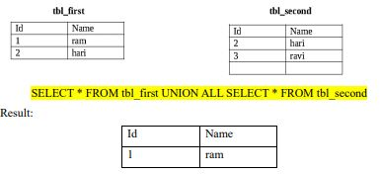


Slide 64

2. INTERSECT:
Intersect operation is used return the records which are common to both SELECT statement.
This operation eliminates the duplicate rows from its result set.
INTERSECT ALL operation can be used if we want to keep duplicate rows in the result table. The INTERSECT query is

Slide 65
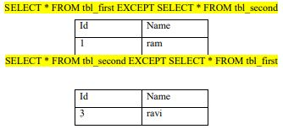
3. EXCEPT:
Except operation returns all records from first table that are not in second table.
This operation eliminate the redundant rows from its result set.
EXCEPT ALL operation can be used if we want to keep duplicate rows in the result table.
The EXCEPT query are

Slide 66
Grouping and Summarizing Data
Summary of the data contains aggregated value that helps in data analysis at broader level.
We can summarize the data using the following aggregate functions.
1. AVG():
Returns the average values in a numeric expression.
E.g. Display the average math mark for the whole school.
SELECT AVG(maths) (AS Averagemathsmarks) FROM tbl_Marks

Slide 67
2. COUNT():
Return the numbers of values in an expression.
E.g. Display the total number of records in table tbl_Marks.
SELECT COUNT(*) AS total FROM tbl_Marks
or
SELECT COUNT(ID) AS total FROM tbl_Marks
Count the total number of unique name in tbl_mark
SELECT COUNT(DISTINCT name) from tbl_Marks

Slide 68
3. MIN():
Returns the lowest value in the numeric expression.
E.g. Display the lowest mark obtained in maths.
SELECT MIN(maths) AS lowestmathmark FROM tbl_Marks
4. MAX():
Returns the highest value in the numeric expression.
E.g. Display the highest mark obtained in maths.
SELECT MAX(maths) AS highestmathmark FROM tbl_Marks

Slide 69
5. SUM():
Returns the sum of values in a numeric expression.
E.g. Display the sum of marks in maths for all students.
SELECT SUM(maths) AS totalmathsmarksofallstudent FROM tbl_Marks

Slide 70
Grouping Data
The GROUP BY clause summarizes the result set into groups as defined in the SELECT statement by using `aggregate function.
The GROUP BY clause is used to group a set of tuples having same value on given attribute. The attribute or attributes given in the GROUP BY clause are placed in one group.
The HAVING clause further restricts the result set to produce the data based on a condition. The HAVING clause is used to specify a selection condition on groups rather than on individual tuples.

Slide 71
Syntax:
SELECT <coloumn_name>, aggregate_functinions (Column_name) FROM <table_name> WHERE<Expression> GROUP BY <column_name> HAVING<Expression with/without aggregate function>
Example 1: Consider the below Relation

Slide 72
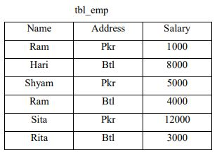

Slide 73

1. Display the minimum and maximum salary paid for a employee of different addresses.
SELECT Address, MIN(Salary) AS minsalary,MAX(Salary) AS maxsalary FROM tbl_emp GROUP BY address
Display the average salary paid for all address except Btl.

Slide 74

SELECT Address, AVG(Salary) AS AverageSalary FROM tbl_emp WHERE Address<>’Btl’ GROUP BY Address
Or
SELECT Address, AVG(Salary) AS AverageSalary FROM tbl_emp GROUP BY Address HAVING Address<>'Btl'

Slide 75
3. Display the maximum salary for each address where the maximum salary is greater than 10000
SELECT Address, MAX(Salary) AS maxsalary FROM tbl_emp GROUP BY address HAVING MAX(Salary)>10000
Address | maxsalary
Pkr | 12000

Slide 76
Subquery / Inner query / Nested query
Subquery is a query that is used within another query i.e. query in query.
Subqueries are nested inside the WHERE clause of SELECT, INSERT, UPDATE and DELETE statement.
The query that represents the parent query is called outer query and the query that represents the subquery is called inner query.
The Database engine first executes the inner query and then outer query to calculate the result set.

Slide 77
Example 1: Consider the tbl_emp relation

Slide 78
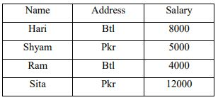
1. Display all the record of employee who have the salary greater than that of Rita
SELECT * FROM tbl_emp WHERE salary > (SELECT salary FROM tbl_emp WHERE name = 'rita')

Slide 79
2. Display all the records of employee whose salary is greater than average salary of all employees
SELECT * FROM tbl_emp WHERE salary > (SELECT AVG(salary) FROM tbl_emp)
Name | Address | Salary
Hari | Btl | 8000
Sita | Pkr | 12000

Slide 80
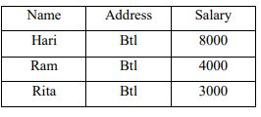
3. Display all the records of employee who have same address as Rita
SELECT * FROM tbl_emp WHERE address = (SELECT address FROM tbl_emp WHERE name='rita’)

Slide 81
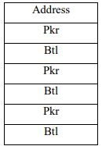
4. Display address for employes whose address is that of Rita or Sita.
SELECT address FROM tbl_emp WHERE address IN (SELECT address FROM tbl_emp WHERE name='Rita' OR name='Sita‘)

Slide 82
Class work

Slide 83
Null Values
With insertions, we saw how null values might be needed if values were unknown. Queries involving nulls pose problems.
If a value is not known, it cannot be compared or be used as part of an aggregate function. However, we can use the keyword null to test for null values:

Slide 84
Example:
select * from tbl_student where middlename is null
i.e. the above queries displays only those records for which the middle name is null.

Slide 85
Join Operation
Join operation is done to retrieve records from multiple tables.
We can join more than one table based on a common attributes. Join operations take two or more relations as input and return a single relation as result.
There are four types of join which are explained below.

Slide 86
1. Inner join:
When an inner join is applied, only rows with values satisfying the join condition in the common column are displayed.
Records in both the tables that do not satisfy the join condition are not displayed.
Syntax:
SELECT <column_names>FROM<table1> INNER JOIN <table2> ON<table1>.<common_field><join operator><table 2>.<common field>
Notes: we can simply use JOIN keyword instead of INNER JOIN keyword in above statement because the inner join is the default join.

Slide 87
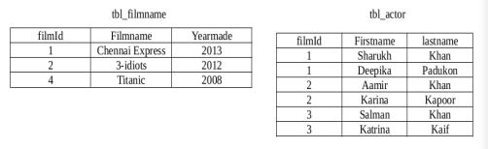
E.g. Let us consider the following two relations.

Slide 88
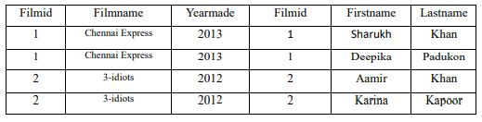
Join the two table tbl_filmname and tbl_actor using inner join.
SELECT Filmid, Filmname, Firstname,Lastname FROM tbl_filmname JOIN tbl_actor ON tbl_filmname.filmid=tbl_actor.filmid
Or
SELECT * FROM tbl_Filmname tf, tbl_actor ta where tf.filmid=ta.filmid

Slide 89
2. Outer Join:
The outer join displays the result set containing all the rows from one table and matching rows from another table.
An outer join displays NULL for the columns of the related table where it doesn’t find matching records.
An outer join is of following types.

Slide 90
a. Left Outer join:
A left outer join returns all the rows from the table specified on left side of LEFT OUTER JOIN keyword and the matching rows from the table specified on the right side.
It displays NULL for the columns of the table specified on the right side where it doesn’t find matching records.
Syntax:
SELECT <column_name> FROM
<table1> LEFT OUTER JOIN <table 2> ON <table1>.<common_field><join operator><table2> .<common_field>

Slide 91
b. Right Outer join:
A right outer join returns all the rows from the table specified on the right hand side of the RIGHT OUTER JOIN keyword and the matching rows from the table specified on the left side.
It displays NULL for the columns of the table specified on the left side where it doesn’t find matching records.
Syntax:
SELECT <column_name> FROM <table1> RIGHT OUTER JOIN <table 2> ON <table1>.<common_field><join operator><table2> .<common_field>

Slide 92
c. Full Outer join:
A full outer join is the combination of left outer join and right outer join which returns all the matching and non matcing rows from both the tables. In case of non matching rows, a NULL values is displayed for the columns for which the data is not available.
Syntax:
SELECT <column_name> FROM <table1> FULL OUTER JOIN <table 2> ON <table1>.<common_field><join operator><table2> .<common_field>

Slide 93
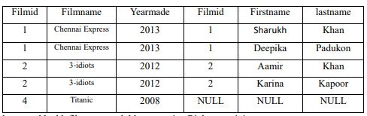
Eg:
1) Join the two table tbl_filmname and tbl_actor using left outer join
SELECT * FROM tbl_filmname LEFT OUTER JOIN tbl_actor ON tbl_filmname.filmid=tbl_actor.filmid

Slide 94
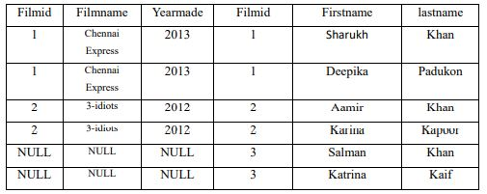
2) Join the two table tbl_filmname and tbl_actor using right outer join
SELECT * FROM tbl_filmname RIGHT OUTER JOIN tbl_actor ON tbl_filmname.filmid=tbl_actor.filmid

Slide 95
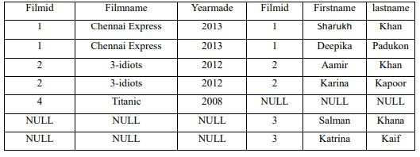
3) Join the two table tbl_filmname and tbl_actor using full outer join
SELECT * FROM tbl_filmname FULL OUTER JOIN tbl_actor ON tbl_filmname.filmid=tbl_actor.filmid

Slide 96
3. Cross join:
A cross join also known as Cartesian product joins each row from one table with each row on the other table.
If P is the number of rows in first table and Q be in second table, then the total number of rows in the result set is P *Q.
Syntax: SELECT<column_names> FROM<table1> CROSS JOIN<table 2>

Slide 97
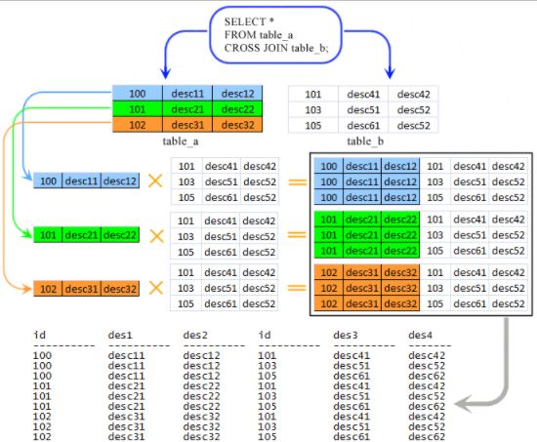

Slide 98
4. Equi join:
A equi join is similar to the inner join with joining condition which is based on the equality between values in the common columns.
Q. How equi-join is different from inner join?
The difference is, equi join is used to retrieve all the columns from both the tables but inner join is used to retrieve selected columns from tables. So using this join operation results a common column to appear redundantly in the resultant table.

Slide 99
Stored Procedure
When a batch of SQL statements needs to be executed more than once, we need to recreate SQL statement and submit them to the server. This leads to an increase in the overhead, as the server needs to compile and create the execution plan for these statements again. Therefore, if we need to execute a batch multiples times, we can save it within a stored procedure. A stored procedure is a precompiled object stored in a database data dictionary.
A stored procedure is also called as proc, sproc or sp and is similar to the user defined functions. Stored procedure can invoke both DDL and DML statements and can return values.

Slide 100
Advantages:
1. Faster
2. Better Security because calls are parameterized.
Disadvantages:
1. Less flexible because we need DBA to make changes

Slide 101
Creating Stored Procedure
We can create stored procedure using CREATE PROCEDURE statement.
Syntax
CREATE PROCEDURE <procedure_name> AS
BEGIN
Sql_statement1
Sql_statement2
Sql_statementN
END

Slide 102
E.g.
CREATE PROCEDURE sp_mobile AS
BEGIN
SELECT * FROM tbl_mobile
END
When the CREATE PROCEDURE command is executed, the server compiles the procedure and save it as a database object.
The procedure is then available for various applications to execute.

Slide 103
Executing a Stored Procedure
A procedure can be executed using EXECUTE or EXEC statement.
Syntax:
EXECUTE | EXEC <procedure_name>
E.g.
EXEC sp_mobile

Slide 104
Altering Stored Procedure
A stored Procedure can be modified by using ALTER PROCEDURE statement.
Syntax:
ALTER PROCEDURE<procedure_name> AS
BEGIN
Sql_statement1
Sql_statement2
Sql_statementN
END

Slide 105
Dropping a stored Procedure
We can destroy a stored procedure form database by using DROP PROCEDURE statement.
Syntax:
DROP PROCEDURE <procedure_name>

Slide 106
Creating a Parameterized Stored Procedure
A parameterized stored procedure is necessary when we need to execute a procedure for different values of a variable that are provided at runtime.
Parameters are used to pass values to stored procedure during run time. Each parameter has a name and its data type

Slide 107
Syntax:
CREATE PROCEDURE <procedure_name>
@parameter1 data type1,
@parameter2 data type2, . .
@parameterN data typeN
As
BEGIN
Sql_statement1
Sql_statement2 .
Sql_statementN
END

Slide 108
E.g.
CREATE PROC sp_mob
@mobile_type varchar(50)
AS
BEGIN
SELECT * FROM tbl_mobile WHERE mobile_type=@mobile_type
END

Slide 109
Query By Example (QBE)
QBE is a graphical query language which is based on the domain relational calculus.
A user needs minimal information to get Started and the whole language contains relatively few concepts. QBE is especially suited for queries that are not too complex and can be expressed in terms of a few tables.
QBE provide a tabular interface that has expressive power of relational calculus in a user friendly form i.e queries look like table.
Here queries are expressed by ‘example’.

Slide 110
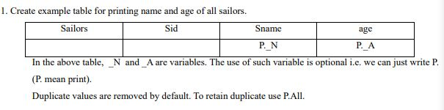
E.g. Let us consider the following three relations.
Sailors (sid, sname, age)
Boats(bid, bname,color)
Reserve(sid,bid,day)

Slide 111
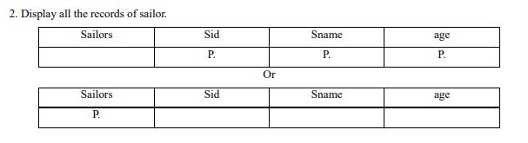
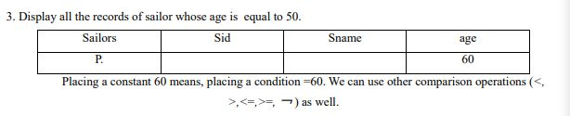

Slide 112
